Slide 1

DIGITAL CLOCK ON PROTEUS
Written by :
David Julian Ernestine (2120010033)
Isaac Gideon Simamora (2120010068)
Muhammad Rafi Aulia (2120010095)

Slide 2
Developed by:
David Julian Ernestine (2120010033)
Isaac Gideon Simamora (2120010068)
Muhammad Rafi Aulia (2120010095)

Slide 3

System analysis
Technology is evolving very fast.

Slide 4
PROTEUS DESIGN
Proteus Name : Digital clock
Component Name :
LED
SWITCH
IC 74192
TTL IC 7408
GROUND
TTL IC 7404
LED-BCD

Slide 5
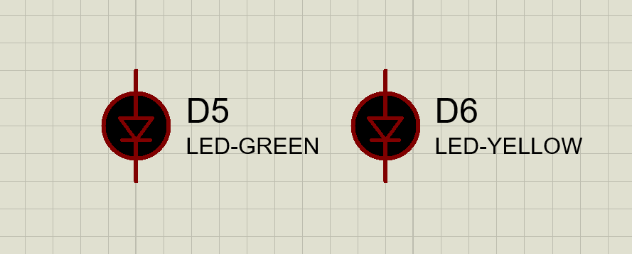
component
LED

Slide 6
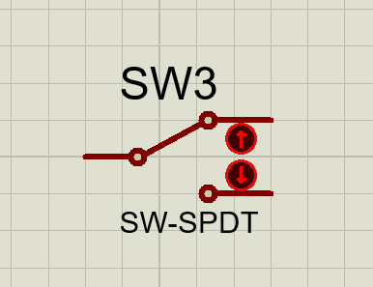
component
SWITCH

Slide 7
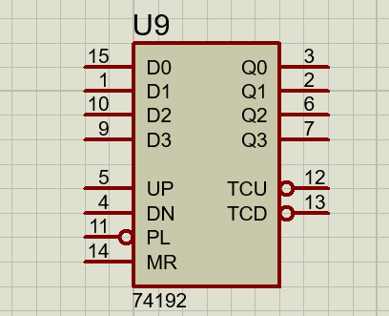
COMPONENT
IC 74192

Slide 8
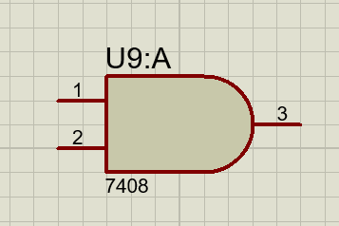
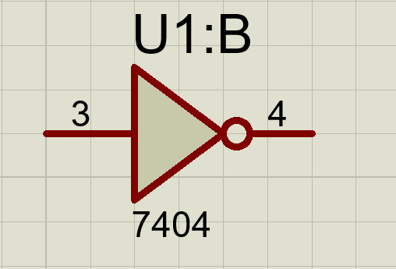
COMPONENT
TTL IC

Slide 9
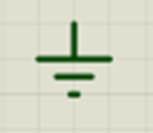
COMPONENT
GROUND

Slide 10
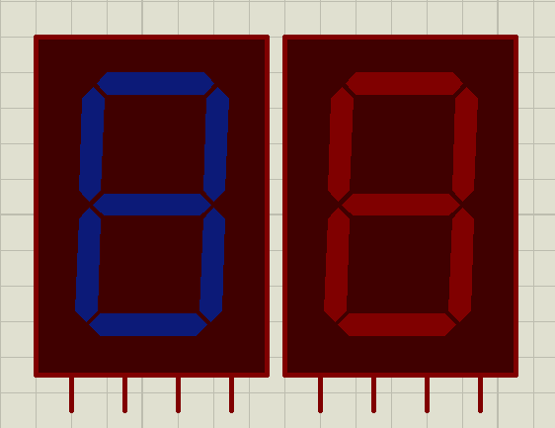
COMPONENT
LED BCD

Slide 11
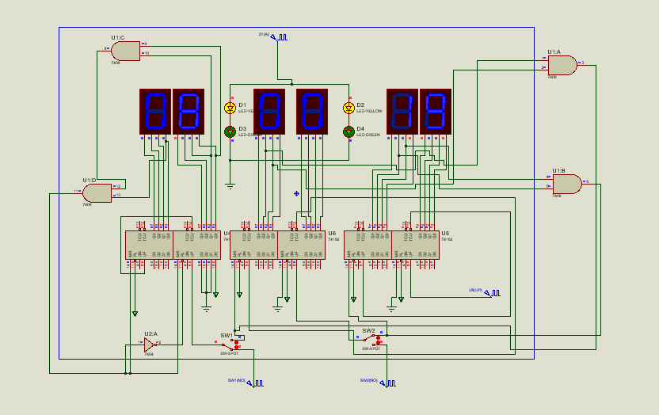
ANALYSIS OF DIGITAL CLOCK

Slide 12
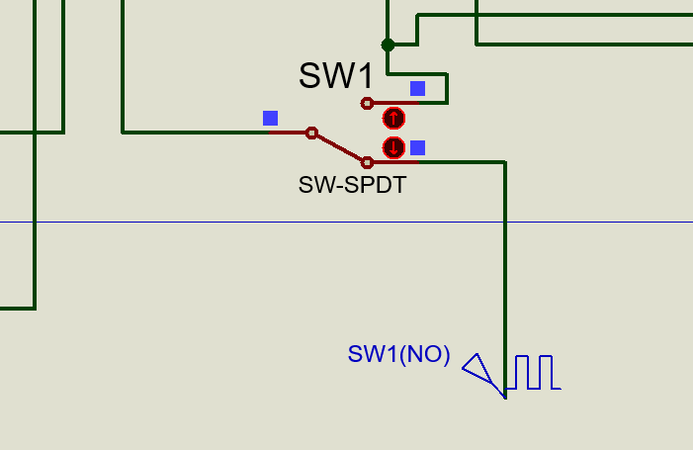
ANALYSIS OF DIGITAL CLOCK

Slide 13
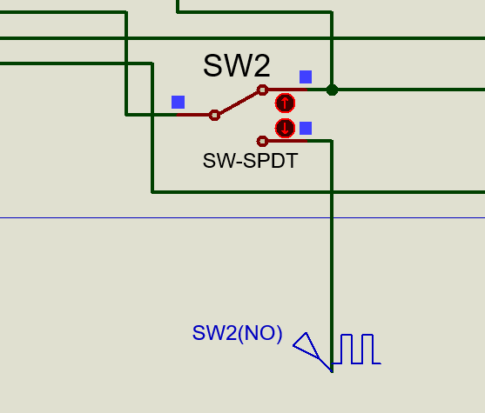
ANALYSIS OF DIGITAL CLOCK

Slide 14
THANK YOU
Written by :
David Julian Ernestine (2120010033)
Isaac Gideon Simamora (2120010068)
Muhammad Rafi Aulia (2120010095)

